Slide 1
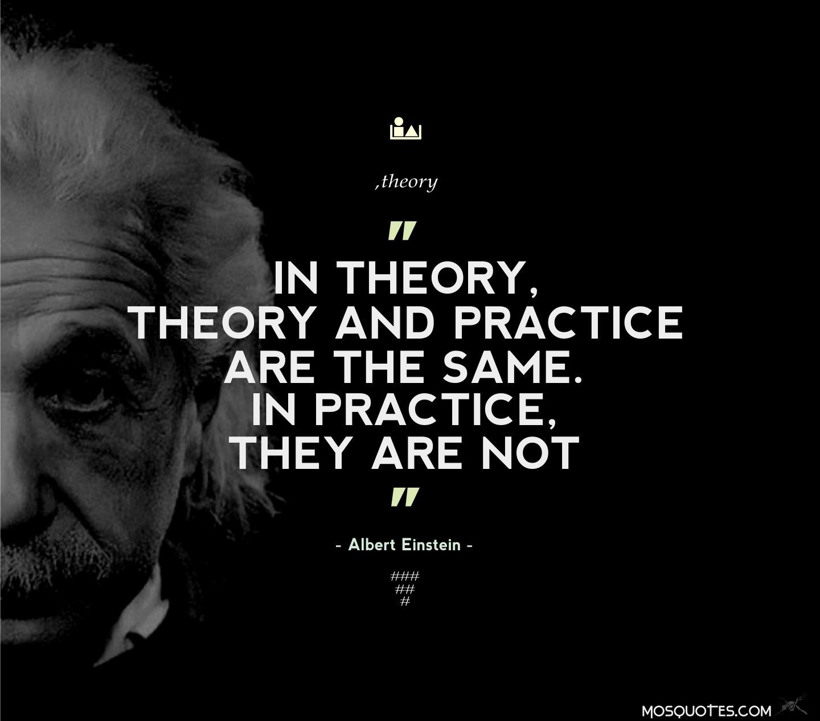
Practicum Project: Taking the course into the wild
December 6, 2018
Purpose, Direction & Last Resort Datasets

Slide 2
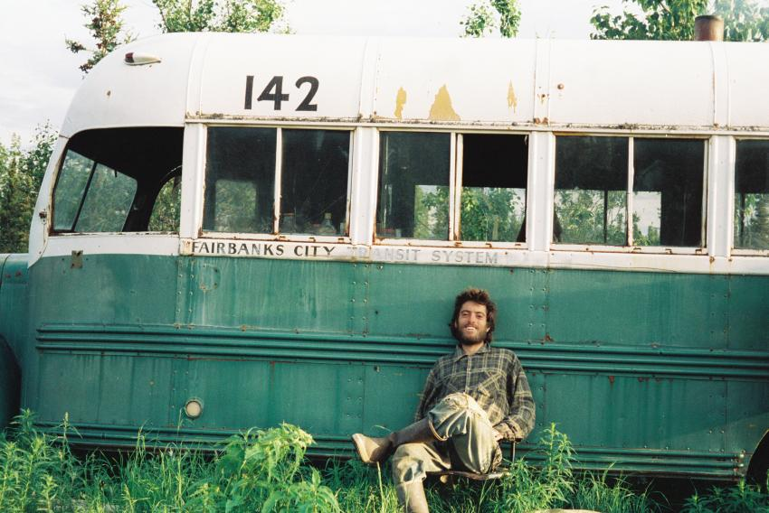
Practicum Project
Identify a data set that is of some importance to you
What questions do you have about it?
Future predictions related to it
Statistically significant differences between subjects within it
Explore it in a new way to get insight
Develop a model to classify future entries

Slide 3


Practicum Project
Follow the work flow you have learned in this course.
For your project attempt to categorize:
How accurate your analysis is
Where uncertainty in your results lie in terms of you the analysis can be generalized.

Slide 4
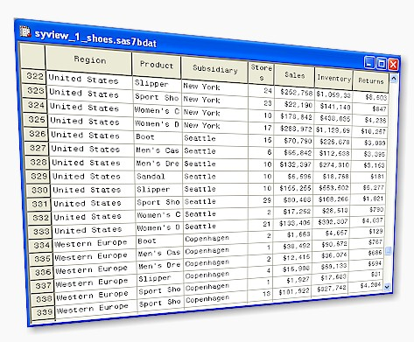

Practicum Project
Your work with this data set at the end of the week will serve as your exam.
If you still have not found a data set we have some to choose from.
Note: Since these have little meaning to you, your work is likely to be less useful.
These are meant to be used as a last resort.

Slide 5
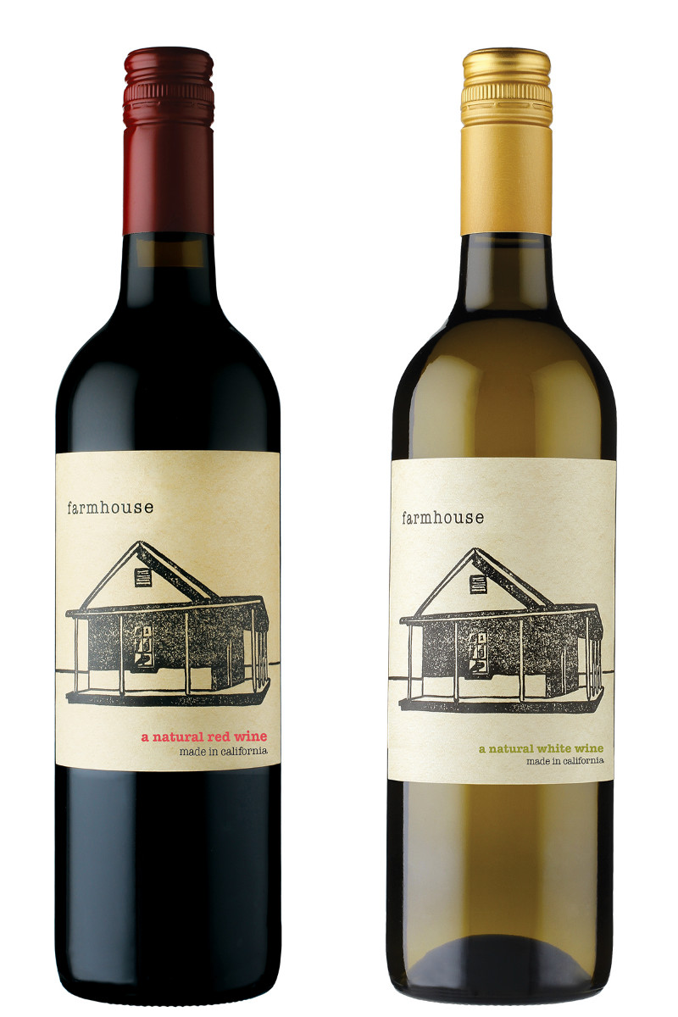
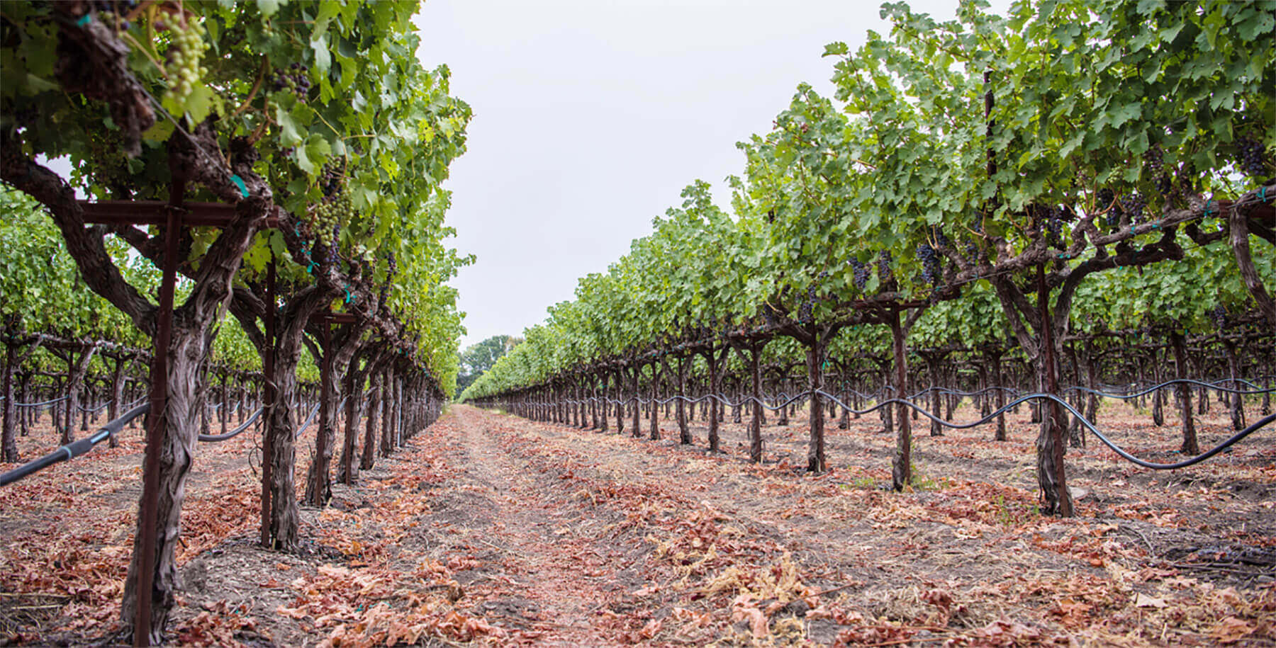
Practicum Project
Datasets at:
https://github.com/rossgore/practicum-projects or on your USB drive
Overview of datasets
Wine Quality (Regression) – Properties of red and white vinho verde wine samples from the north of Portugal. The goal is to model wine quality based on physicochemical tests.
You may need to create two separate models one for red wines and one for white wines.

Slide 6
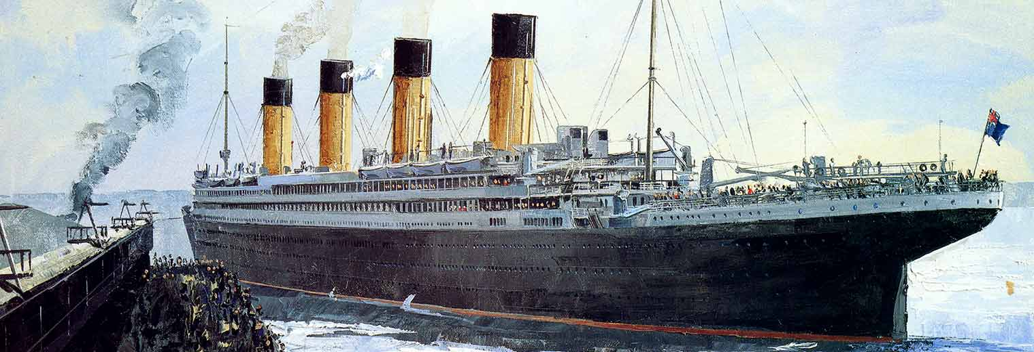
Practicum Project
Datasets at:
https://github.com/rossgore/practicum-projects
Overview of datasets
Titanic (Classification) – contains data for 887 of the real Titanic passengers. Each row represents one person. The columns describe different attributes about the person including:
Survived - If the passenger survived
Pclass - the passenger class (1st class, 2nd class, 3rd class)
Name - the passenger's name
Sex - the gender of the passenger
Age - the age of the passenger
Siblings/Spouses - the number of siblings and spouses the passenger had
Parents/Child Aboard - the number of parents and/or childer aboard the passenger had
Fare - the price of the fare the passenger paid.

Slide 7
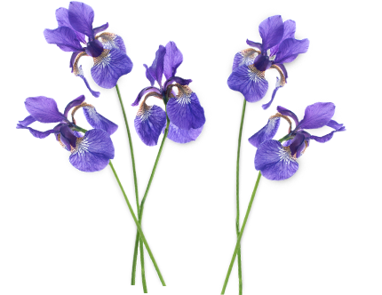

Practicum Project
Datasets at:
https://github.com/rossgore/practicum-projects or on your USB drive
Overview of datasets
Iris (Classification) - 50 samples from each of three species of Iris (Iris setosa, Iris virginica and Iris versicolor). Four features were measured from each sample: the length and the width of the sepals and petals, in centimeters.
You can build a model to classify each of the different species based on sepals and petals length and width.

Slide 8

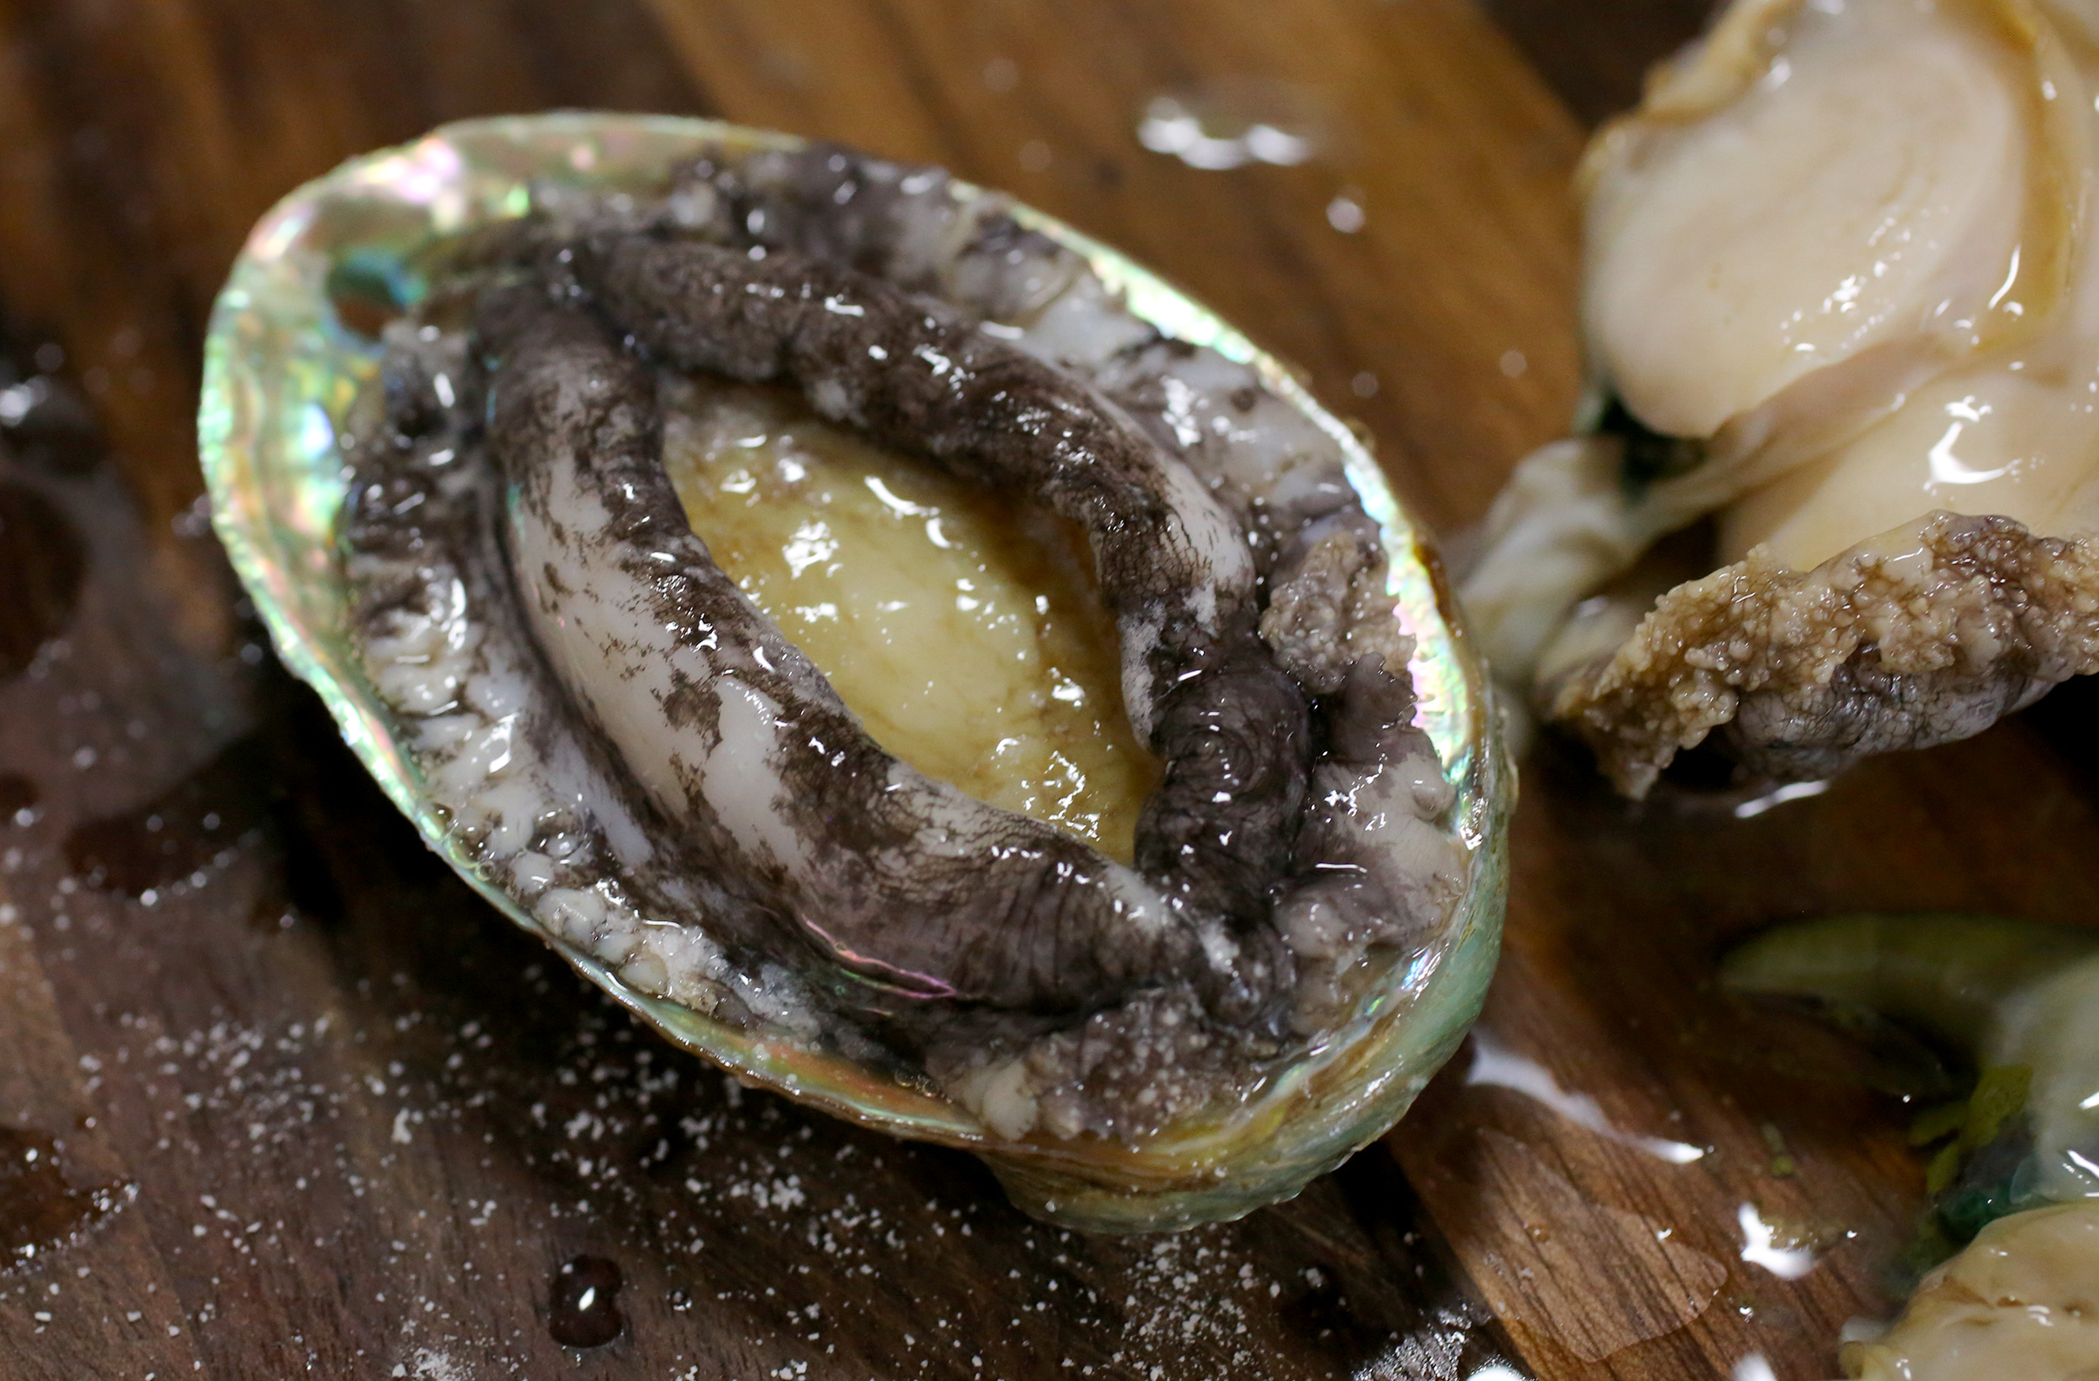
Practicum Project
Datasets at:
https://github.com/rossgore/practicum-projects
Overview of datasets
Abalone (Classification / Regression) - Predicting the age of abalone from physical measurements. The age of abalone is determined by cutting the shell through the cone, staining it, and counting the number of rings through a microscope. Other measurements, which are easier to obtain, are used to predict the age.
IMDB (Classification / Regression) – Lots of attributes of IMDB movies. Attempt to predict budget, imdb score, color, duration, etc.

Slide 9
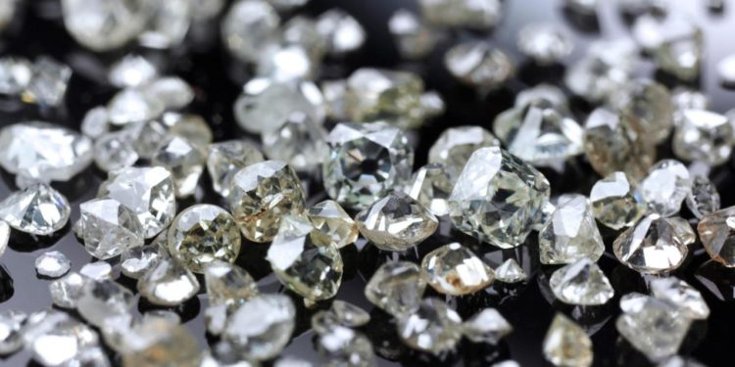
Practicum Project
Datasets at:
https://github.com/rossgore/practicum-projects or on your USB drive
Overview of datasets
Diamonds - predict the price of a diamond based on a number of variables related to size, clarity, color, cut and more. Visualize the relationship of different data attributes.

Slide 10


Practicum Project
Datasets at:
https://github.com/rossgore/practicum-projects or on your USB drive
Overview of datasets
Type 2 diabetes rate in Pima Native Americans- predict incidence of diabetes in Pima Native Americans based on different measurements: obesity, insulin resistance, insulin secretory dysfunction, and increased rates of endogenous glucose production.

Slide 11
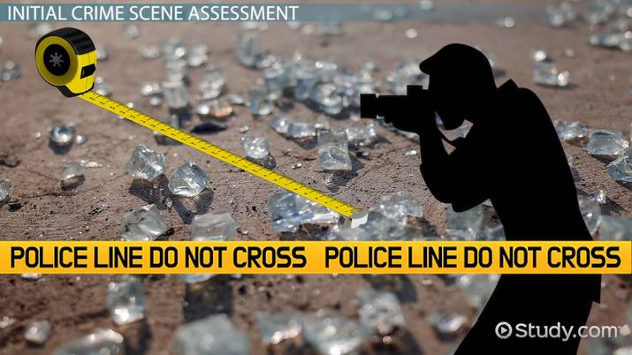
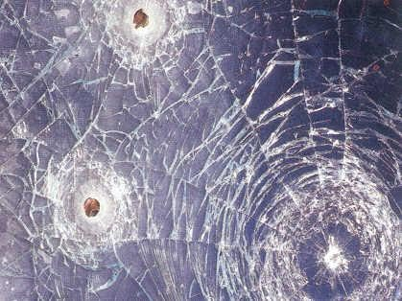
Practicum Project
Datasets at:
https://github.com/rossgore/practicum-projects or on your USB drive
Overview of datasets – Glass Type Classification
The study of classification of types of glass was motivated by criminological investigation. At the scene of the crime, the glass left can be used as evidence...if it is correctly identified!

Slide 12
Practicum Project
Datasets at:
https://github.com/rossgore/practicum-projects
Overview of datasets – Glass Type Classification
The study of classification of types of glass was motivated by criminological investigation. At the scene of the crime, the glass left can be used as evidence...if it is correctly identified!

Slide 13
Practicum Project
Datasets at:
https://github.com/rossgore/practicum-projects or on your USB drive
Overview of datasets – Glass Type Classification
The study of classification of types of glass was motivated by criminological investigation. At the scene of the crime, the glass left can be used as evidence...if it is correctly identified!

Slide 14
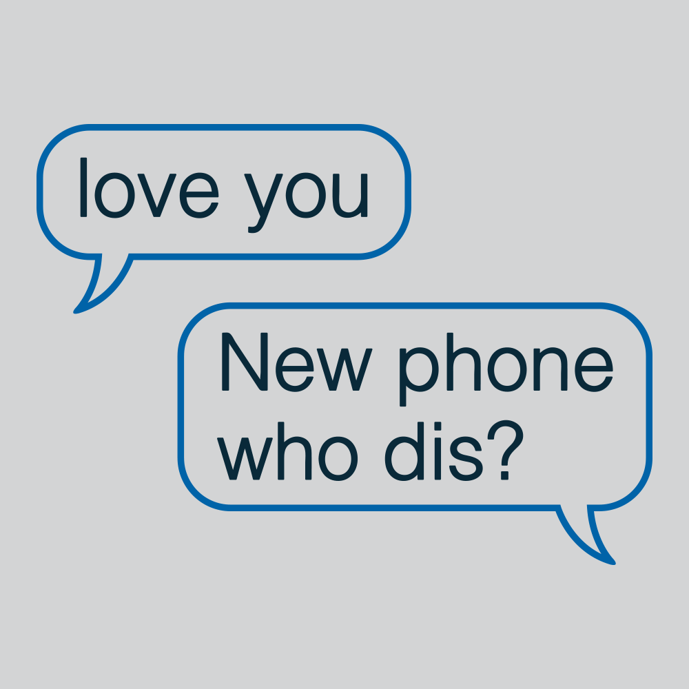

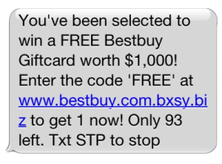
Practicum Project
Datasets at:
https://github.com/rossgore/practicum-projects or on your USB drive
Overview of datasets – Spam Detection – Ham or Spam
Build a machine learning model and supporting analysis to determine if a text message is legitimate (ham) or SPAM. You will want to follow a similar workflow as we did with the congressional bills.

Slide 15
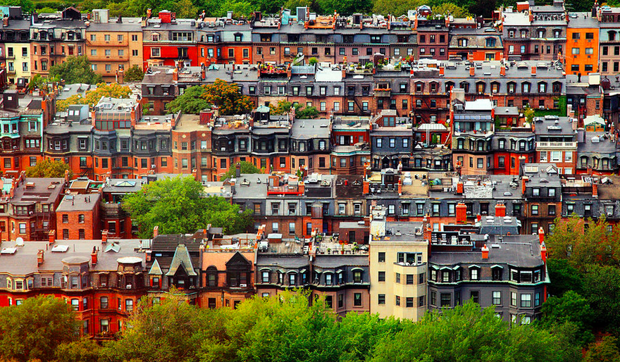

Practicum Project
Datasets at:
https://github.com/rossgore/practicum-projects or on your USB drive
Overview of datasets – Boston Housing
Visualize, explore correlations or predict different variables within the US Census related to different residential zones in Boston Massachusetts.

Slide 16
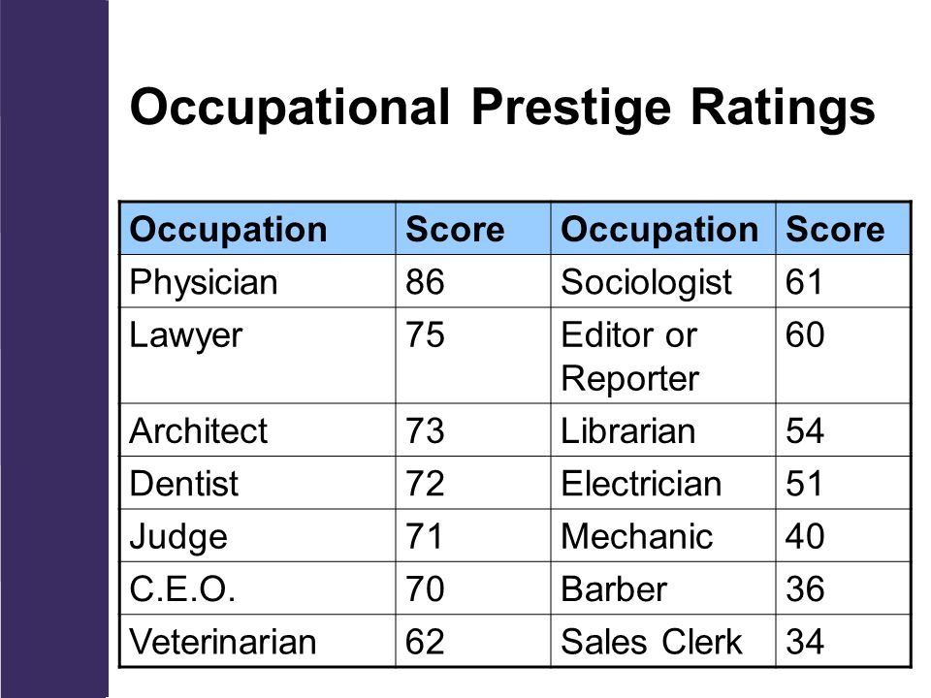
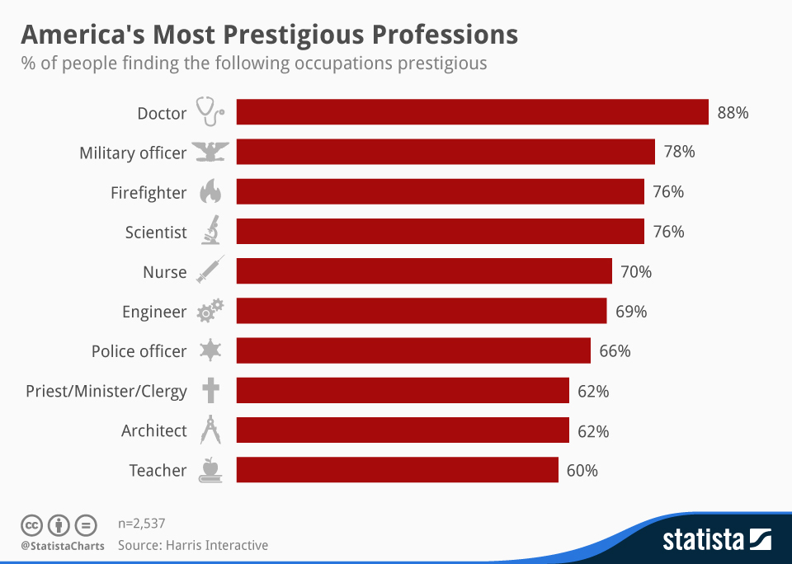
Practicum Project
Datasets at:
https://github.com/rossgore/practicum-projects or on your USB drive
Overview of datasets – Occupation Prestige
Build a regression model to predict the prestige of an occupation in Canada based on as many as three different indicator variables including: education level, income level and % of women currently in the profession.

Slide 17
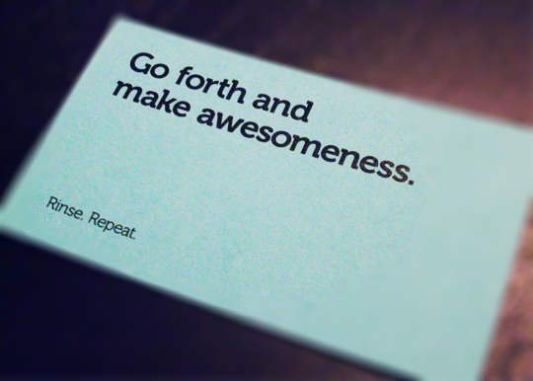
Practicum Project
We are here to help you throughout this. Now ….

